Slide 1


2017 UA/NASA Space Grant Symposium
April 22nd, 2017, Phoenix, AZ
Flow Features of 3D Shock Wave Boundary-Layer Interactions
Marcos De Rose¹
Jesse Little²
Funded by AFOSR-FA9550-15-1-0430
1. Research Intern
2. Associate Professor
3. Assistant Research Scientist
4. Graduate Student
Acknowledgements:
James Threadgill³
Adam Doehrmann⁴

Slide 2
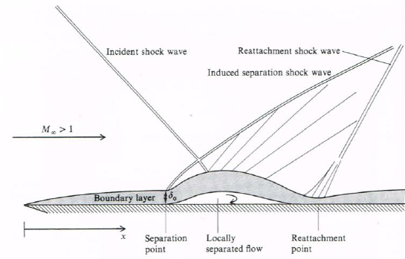

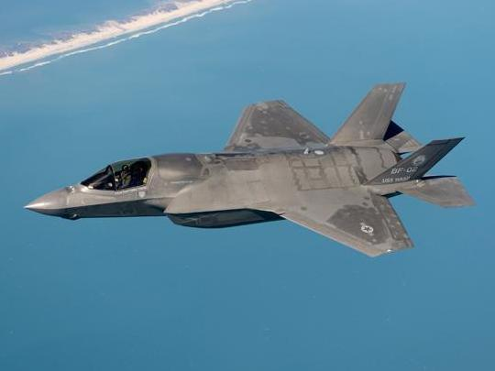
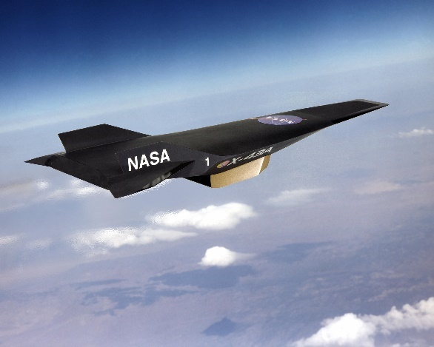
Background
Shockwave and boundary layer interactions (SBLIs) occur on high speed vehicles
Complexity added with sweep
Influence of sweep and 3D effects are still not well understood in literature
Image: Engineering Project Conference
Image: Boeing
Image: Lockheed Martin
Image: NASA
Notes:
Background:
Shockwaves are created when objects move faster than the speed of sound and generate very sharp changes in fluid properties.
Boundary layers are thin layers of viscous flow along a surface that create drag.
The complexity of shockwave boundary layer interactions or SBLIs arises from the combination of the sharp increase in pressure across a shock wave and the separated viscous flow in the boundary layer.
The addition of sweep can make flow three-dimensional and has received little attention in literature.

Slide 3
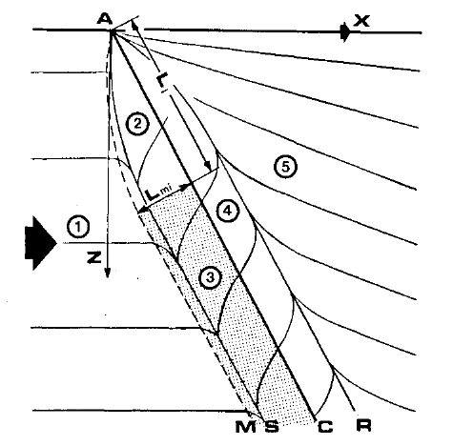
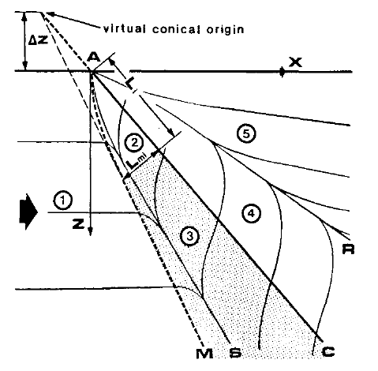
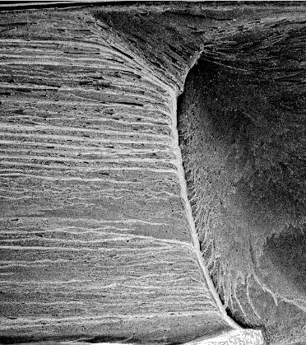
Objective
Characterization of flow interaction between separation and reattachment at moderate Mach Numbers using two swept shock generators
Comparison between theoretical and experimental sweep flow
Oil flow visualization of interactions to characterize flow
Cylindrical
Conical
Root
Tip
Settles and Teng (1984)
Notes:
Objective:
The interaction region between separation and reattachment is the focus of this study.
Two different states for this interaction: cylindrical and conical.
Cylindrical Similarity: as you move along the sweep, this region stays constant making it similar to planar 2D interactions.
Conical Similarity: the interaction region increases from root to tip and has been observed previously in high sweep angles and high Mach values.
Oil flow is used to see a visual of skin friction streaklines giving the distinction between cylindrical and conical interactions.

Slide 4
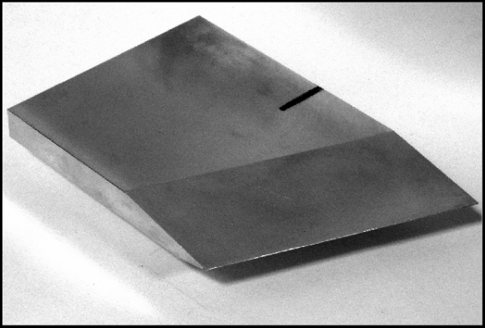
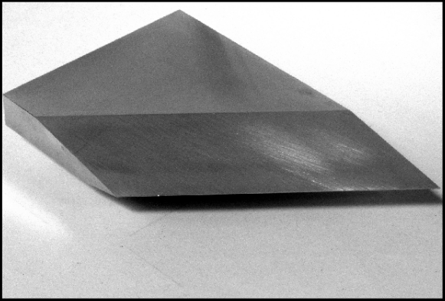
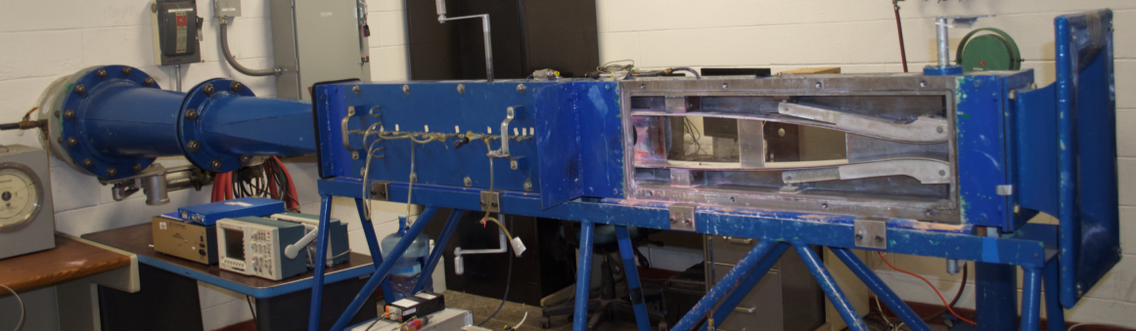


Experimentation
Indraft Supersonic wind tunnel
Adjustable throat for Mach 1.5 to 5
Run times of approximately 20 seconds
Two shock generators tested at Mach 3:
          22.5° sweep sharp fin wedge
          40° sweep sharp fin wedge
$$ψ=22.5°$$
$$ψ=40.0°$$
Threadgill (2017)
Notes:
Experimentation:
The Supersonic wind tunnel at University of Arizona takes room temperature air and sucks it through an adjustable throat nozzle.
For this experiment, I compared two different shock generators: one with a 22.5° sweep and the other with a 40° sweep at Mach 3.
These wedges are then placed in the test section with the top root face coinciding with the top of the test section.

Slide 5
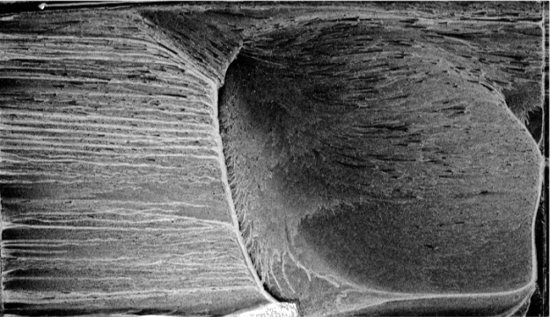
Oil Flow Visualization
UV oil is painted along the wind tunnel mirror
Oil flow presents skin-friction stream lines, shock waves, and separation features
Difficulty in creating an effective mixture
SBLI region is between separation and reattachment lines
Shock Generator
Threadgill (2017)
Separation
Reattachment
Notes:
Oil Flow Visualization:
A mixture of brake oil and UV powder is painted onto the inner window of the tunnel and then a camera records a video of the window.
In the picture, flow moves left to right. At the midpoint, we see the separation line created by the shockwave. This is the SBLI region of focus.
After this line, flow begins to separate and reattach on the line seen in yellow.
The shock generator is seen in green as a point of reference.
This specific image shows a conical similarity with the flow spinning in a cone between the blue and yellow lines.

Slide 6
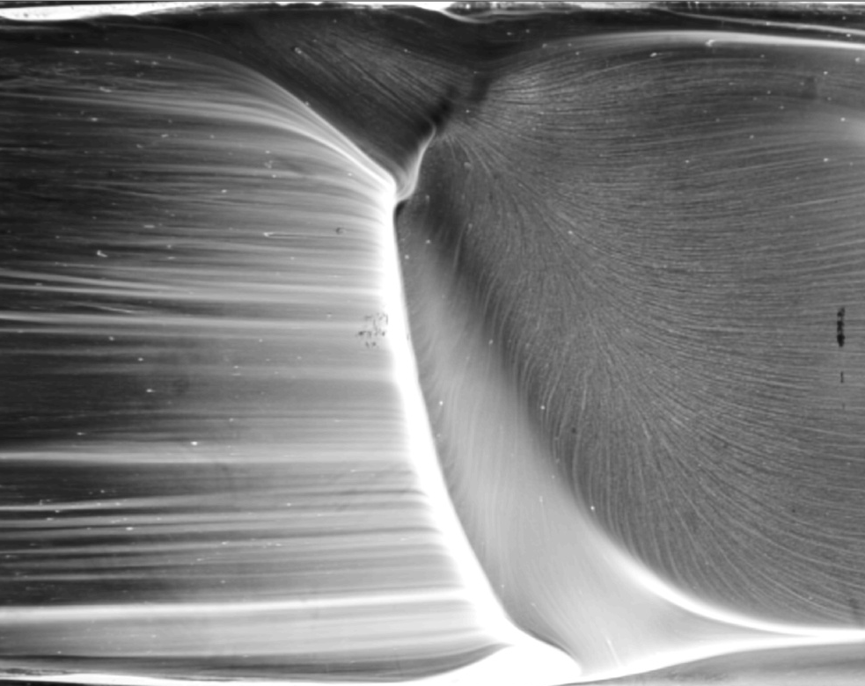
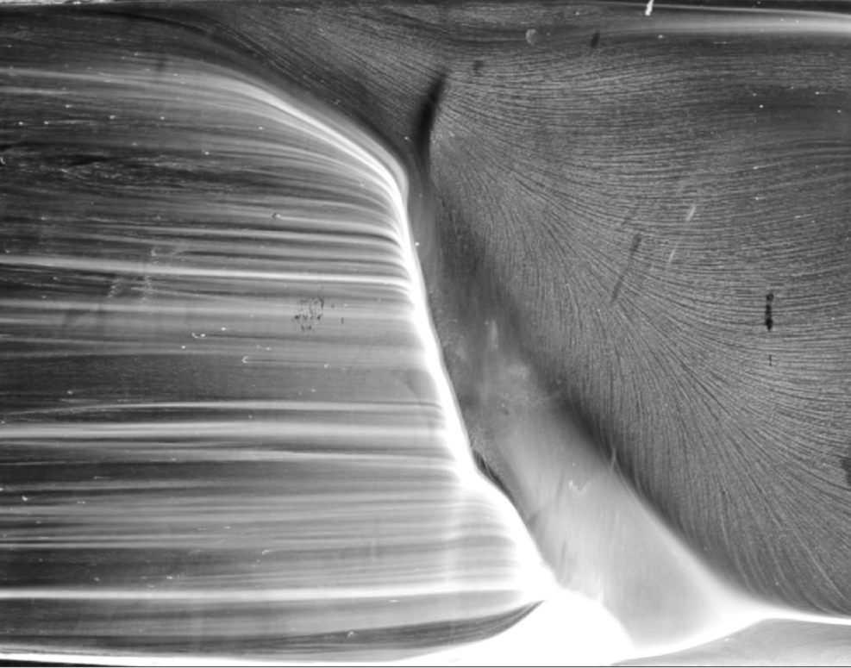
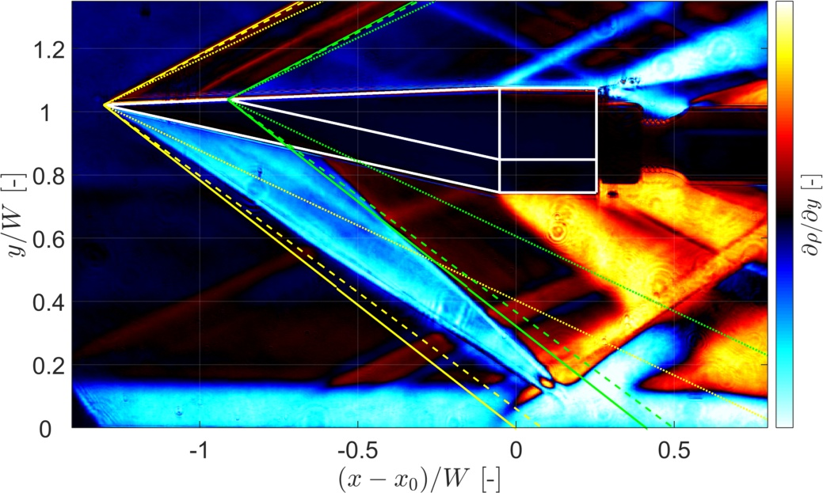
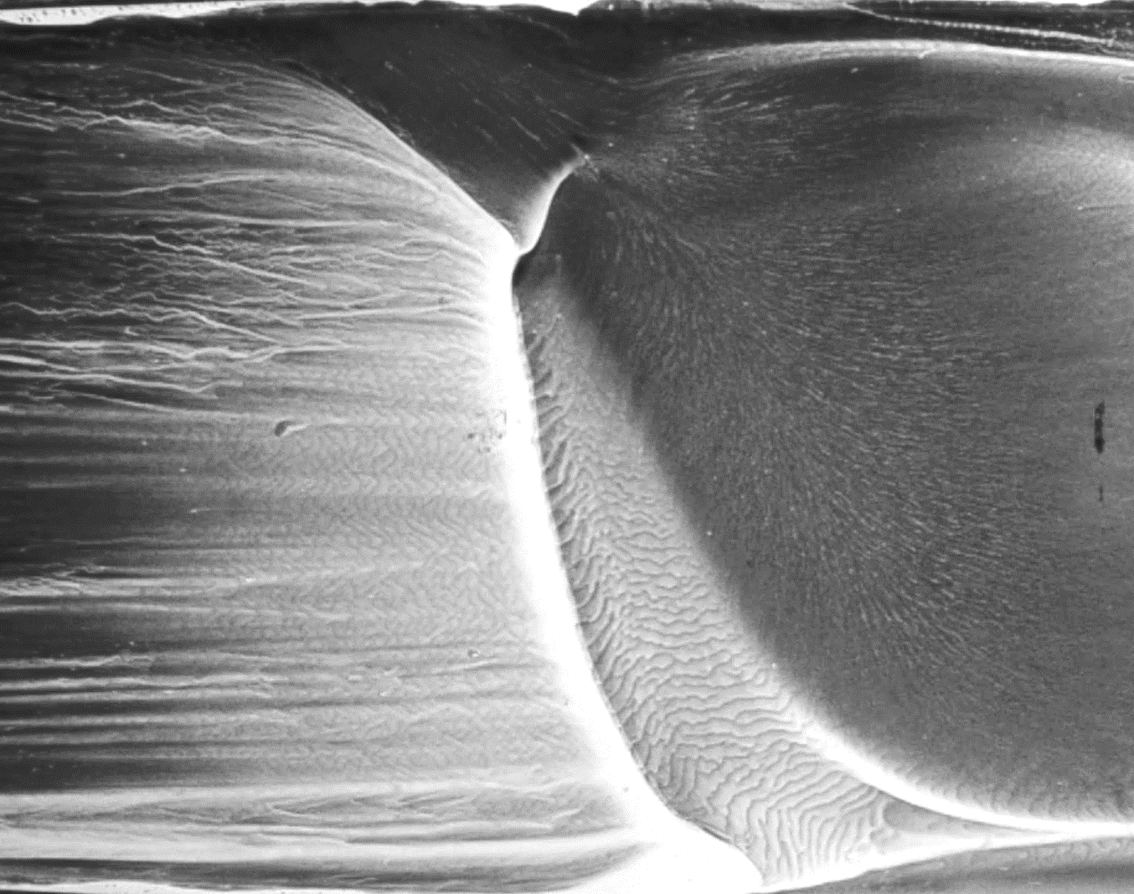
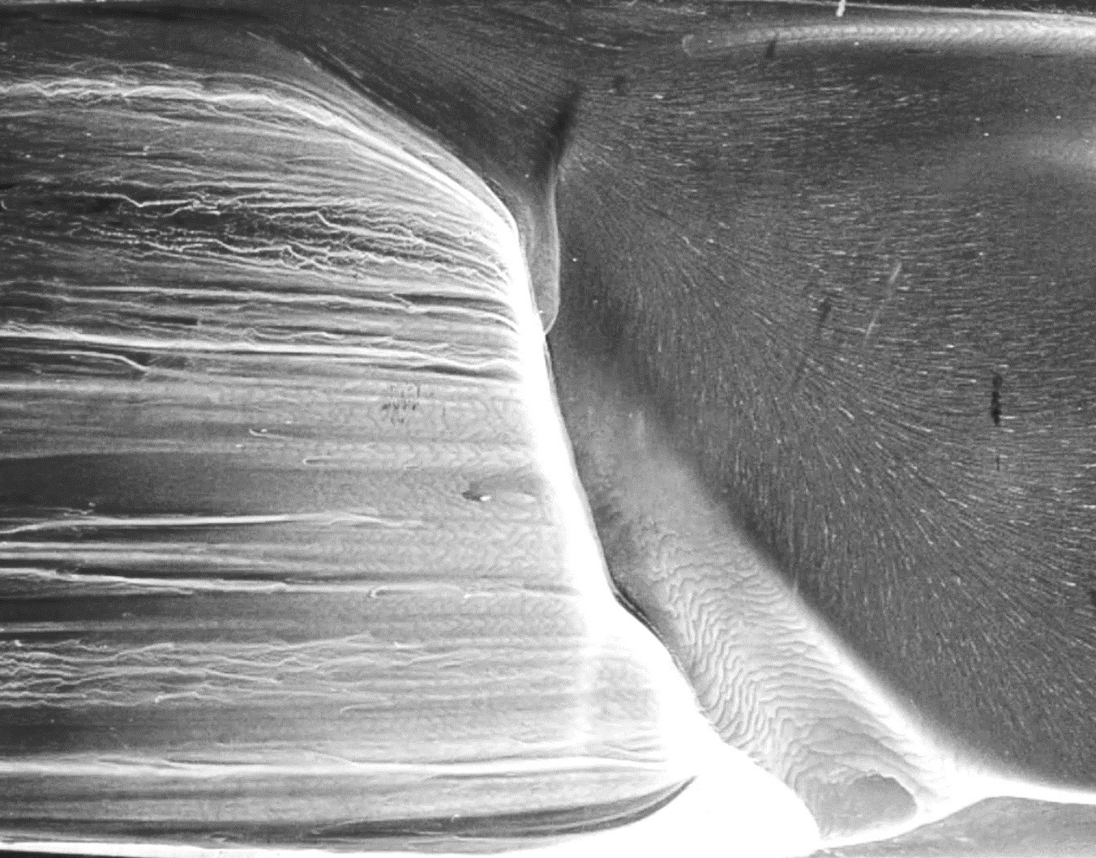
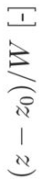


Results
M = 3.0, $ψ$ = 22.5°
M = 3.0, $ψ$ = 40.0°
Threadgill (2017)
Threadgill (2017)
Conical Similarity
Conical Similarity
The theory states that at 22.5° sweep angle, the interaction should be cylindrical. The 40° sweep interaction is predicted as conical.
Notes:
Results:
The results of the oil flow are presented here.
The sweep angle of 22.5° shows some level of a conical region which is not predicted by theoretical.
The sweep angle of 40° created a conical similarity with the separation and reattachment lines pointing towards the root. This is what the theory expects and matches the experimental.

Slide 7
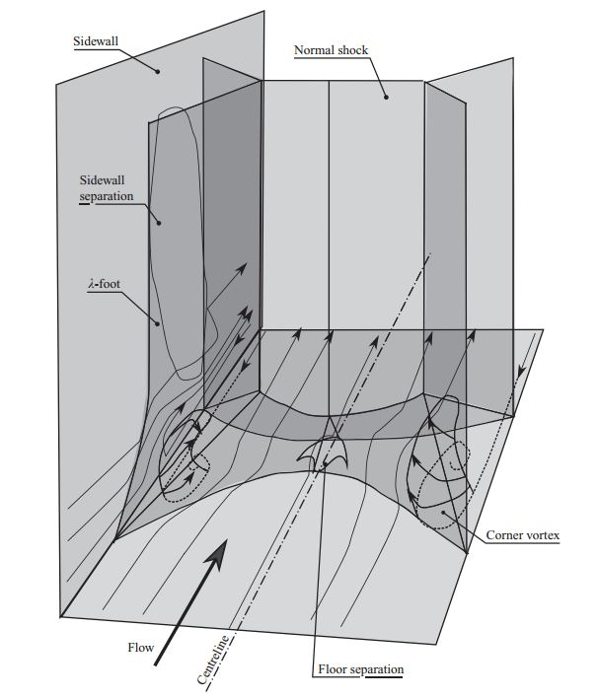
Corner Effects
Are conical results just a consequence of corner disturbances?
The corners of the test section create corner vortices
These vortices may be the cause of conical interactions in the 22.5° case
Threadgill (2017)
Corner Separation
Bruce et. all (2011)
Notes:
Corner Effects:
Corner effects are disturbances created by vortices in the corners of the test section. These vortices may interact with the SBLI region
This is an argument why the experimental interaction in the 22.5 swept wedge is seen as conical.

Slide 8
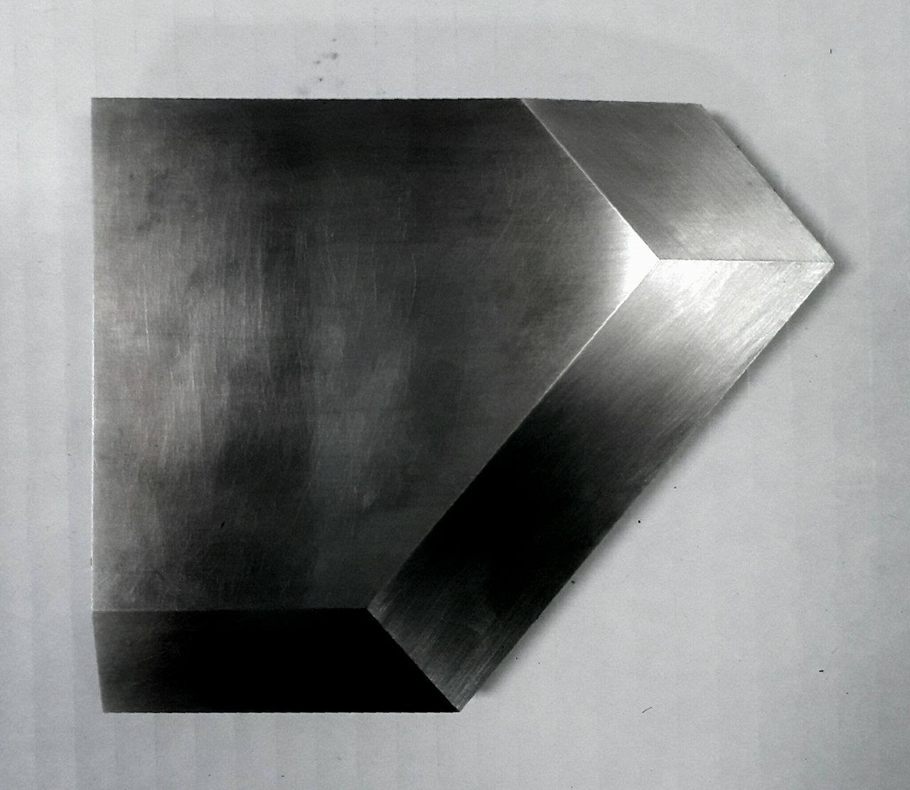
Conclusions & Future Work
Highly swept SBLIs confirm predicted conical similarities
Conical separation at more moderate angles showed unpredicted level of conical flow
Future work involves Chevron Cut wedge which is designed to avoid and reduce the strength of corner effects
Wedge would create a virtual slip wall
Chevron Cut Shock Generator
Notes:
Conclusions:
The high swept case confirmed the conical similarities that were seen in previous research,
The lower sweep showing conical flow was unpredicted. Corner effects are a variable that will be studied in future work
By using a wedge cut in a chevron shape, a virtual slip wall is hopefully created which avoids the corner effects.

Slide 9
References
Bruce, P. J. K., Burton, D. M. F., Titchener, N. A. and Babinksy, H., "Corner Effect and Separation in Transonic Channel Flows,” Fluid Mechanics Journal, Vol. 679, 2011, pp. 247-62.
Settles, G. S. and Teng, H.-y., “Cylindrical and conical flow regimes of three-dimensional shock/boundary-layer interactions,” AIAA Journal, Vol. 22, No. 2, 1984, pp. 194–200.
Threadgill, James. "Three-Dimensional Flow Features of Swept Impinging SBLI." AIAA SciTech. Texas, Grapevine. Lecture.

Slide 10
Thank You
UA/NASA Space Grant Symposium
April 22, 2017

